Slide 1
Systematic Case Presentation
Company E
Anders, Christian, David, Michael and Peter
15/10 2010
Notes:
Peter

Slide 2
Work process
Stakeholder requirements definition process
Requirement analysis process
→ Case specific SRS (as main-contractor)
→ Case specific SRS (to sub-contractor)
Architectural design process + Systematic template
→ Case specific DDD (as main-contractor)
→ Case specific DDD (as sub-contractor)
→ Case specific ICD
Contact to our sub-contractor
→ Analysis → Requirements → Initial contact → Clarification of requirements → Answer → Final meeting
Notes:
Michael

Slide 3
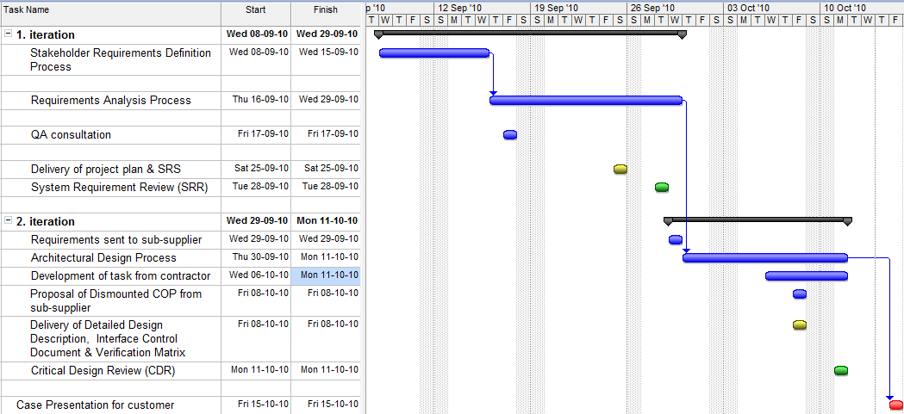
Scheduling
Notes:
Christian

Slide 4
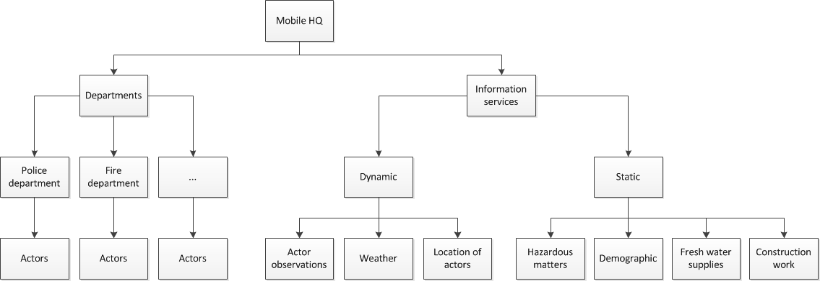
Case focus
Notes:
Christian

Slide 5
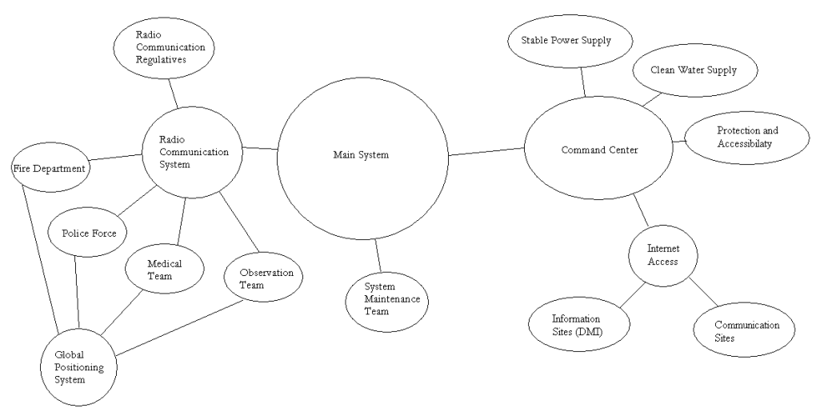
Requirements Elicitation
Notes:
Anders

Slide 6
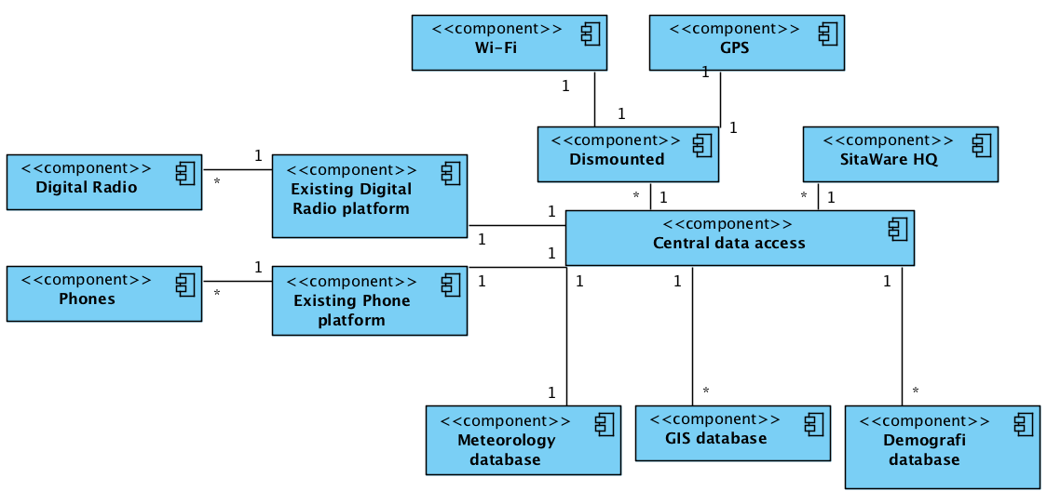
Design Elements
Notes:
David

Slide 7
Dismounted COP
Notes:
1Kg max
direct sunlight
Batteritype Cobolt/Phosphate Li-Ion
½kg battery => 3hrs direct sunlight @ 9.7"
glove / Adm Mode
IPad Like
Shock Resistant
Communication via GSM/SAT/WLAN
Audio Conference Call

Slide 8
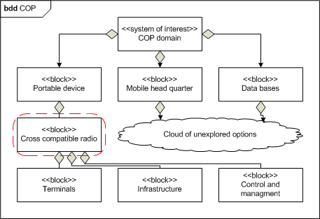
Interface Elements
Notes:
Michael

Slide 9
Future work
Domain knowledge
Role of involved actors
Hardware
Adjustment of SitaWare platform e.g. new radio unit
Software
User interface / user experience
Communication interface structure
Notes:
Alle i kor…

